Slide 1
ADVANCED PROGRAMMING-ITIC 2223
Lecture 02-Python Data Types
Ramesh Madhuranga
MPhil.(Reading) (USJP), BICT (Hons) (RUSL), AMCSSL
Department of Biosystems Technology
Faculty of Technology
Kotelawala Defence University

Slide 2
Python Data Types
Every value in Python has a data type.
Since everything is an object in Python programming, data types are classes and variables are objects of these classes.
There are various data types in Python.

Slide 3
Python Data Types
Numbers
String
List
Tuple
Dictionary

Slide 4
Numbers
Python supports integer, float and complex classes.
Integers are whole numbers.
ex:5,100
Floating points are shown by the presence of a decimal point.
ex: 5.0,6.4

Slide 5

Strings
Strings are immutable sequence of characters.
These are inserted either in “ ” or „ ‟.
A double quote (“ ”) can contain a single quote („ ‟).

Slide 6
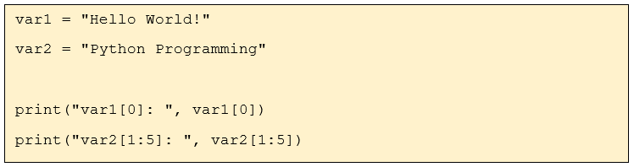
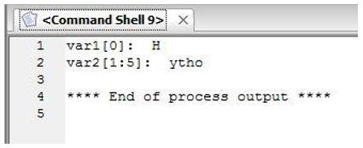
Printing a Character or Set of Characters within a String

Slide 7
Lists
List is a frequently used data type in Python.
List is created by placing all the items (elements) inside a square bracket [ ], separated by commas.
ex: list1= [ 1, 2, 3, 4 ]
It can have any number of items and they may be of different types (integer, float, string etc.).
ex: list2= [ 1, “abc”, 2.6, 'a' ]

Slide 8
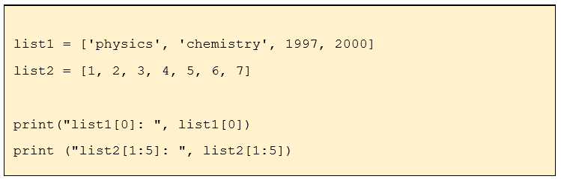
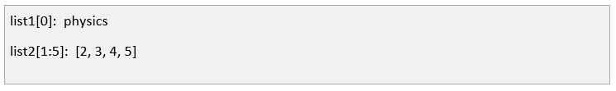
Accessing Values in a List
Example:
Output:

Slide 9
Tuples
A tuple is created by placing all the items (elements) inside parentheses (), separated by commas.
A tuple can have any number of items and they may be of different types.

Slide 10
Tuples
Tuple is putting different comma-separated values between parentheses().
ex: tuple1 = (1, “abc”, 2.6, „a‟)
Empty tuple is written two parentheses containing nothing. ex: tuple2 = ()
Tuple containing a single value : ex: tuple3 = (1,)

Slide 11
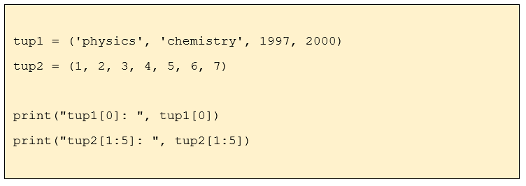
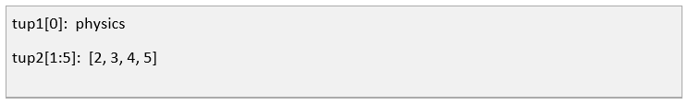
Accessing Values in a Tuple
Example:
Output:

Slide 12
Dictionary
Python dictionary is an unordered collection of items that has a key: value pair.
Also known as associative arrays or hash tables.
It is written by placing items inside curly braces {} separated by comma.
ex: { “name”: “Jane” , “age”: 14, “grade”: 8 }
Values can be of any data type and can repeat and keys must be unique.

Slide 13
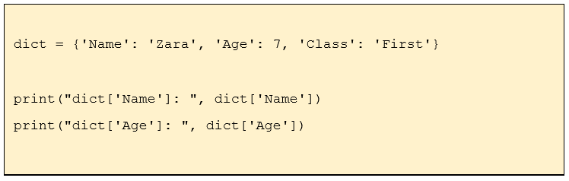
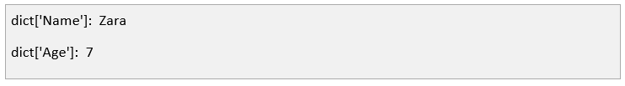
Accessing Values in a Dictionary
Example:
Output:

Slide 14
Activity 01
marks = [78, 85, 92, 67, 88, 95, 73]
Print the first and last marks.
Display the highest and lowest marks.
Calculate the average mark.
Add a new mark (81).
Remove the mark 67.
Sort the list in ascending order.
Display only the first three marks after sorting.

Slide 15
HAVE A NICE DAY!

